Slide 1

DEPARTMENT OF COMPUTER SCIENCE AND ENGINEERING
Project name : Public Transport Optimization
Team name : Proj_224782_Team_4
Team members :
ASHWINI E(113321104006)
BENSIHA A(113321104008)
DEYAA ASMI M(113321104013)
DHANALAKSHMI S(113321104014)

Slide 2
PROJECT
Optimizing public transport with IoT (Internet of Things) involves using smart devices and data analytics to enhance efficiency, safety, and passenger experience.
This project meets the evolving needs of the community while reducing traffic congestion and environmental impact. IoT can play a pivotal role in making public transport more efficient, convenient, and sustainable.

Slide 3
innovation
Predictive Analytics: Using machine learning and AI algorithms to predict demand patterns and optimize routes and schedules accordingly, reducing wait times and overcrowding.
Infrastructure and Accessibility Improvements: Building or renovating stations and stops to be more accessible and user-friendly, including features like bike racks, Wi-Fi, and charging stations.
Integration with Other Services: Integrating public transport with other essential services like healthcare, education, and last-mile connectivity to enhance the overall quality of life for residents.
Smart Payment Systems: Implementing contactless payment methods and digital ticketing to streamline the boarding process and make it easier for passengers to access services.
Real-time Data and Tracking: Implementing GPS and sensor technologies to track vehicles and gather real-time data on passenger loads, traffic conditions, and delays. This data can be used to optimize routes and schedules.

Slide 4
Platform required
API Integration: Supporting open APIs for third-party developers to create complementary apps and services.Route Optimization
Real-Time Data Integration: The platform should be capable of collecting and integrating real-time data from various sources, such as GPS tracking, passenger counting sensors, and traffic management systems.
Route Optimization: Algorithms for optimizing routes, schedules, and stop locations to minimize travel time and improve service reliability.
Demand Forecasting: Using data analytics to predict passenger demand and adjust services accordingly.
Traffic Management : Integrating with traffic control systems to prioritize public transport vehicles and reduce congestion.

Slide 5
objectives
Reduce travel time: Optimize routes and schedules to minimize travel time for passengers, making public transport a more time-efficient
Reduce environmental impact: Transition to cleaner and more sustainable modes of transport, such as electric buses or trains, to lower emissions and improve air quality.
Enhance the passenger experience: Provide comfortable and convenient services, including digital ticketing, real-time updates, and quality amenities.
Improve safety and security: Ensure the safety of passengers and staff, including security measures and emergency response systems.
Financial Sustainability: Increase ridership: Attract more passengers by offering reliable and efficient services.
increased Accessibility: Expand coverage: Provide public transport services to a broader geographic area, making it accessible to more people, including underserved communities.

Slide 6
Sample code
import paho.mqtt.client as mqtt
import time
import json
from scipy.optimize import linprog
import math
# Define the MQTT broker address and topic
MQTT_BROKER_ADDRESS = "localhost"
MQTT_TOPIC = "public_transportation"
# Create an MQTT client
client = mqtt.Client()
# Connect to the MQTT broker
client.connect(MQTT_BROKER_ADDRESS)
# Subscribe to the MQTT topic
client.subscribe(MQTT_TOPIC)

Slide 7
# Define a callback function to handle incoming MQTT messages
def on_message(client, userdata, msg):
# Decode the JSON message
data = json.loads(msg.payload.decode())
# Get the sensor data
ridership = data["ridership"]
location = data["location"]
predicted_arrival_time = data["predicted_arrival_time"]
# Update the public transport optimization model
# ...
# Start the MQTT client loop
client.loop_forever()
# Define the public transport optimization model
def public_transport_optimization(ridership, locations, predicted_arrival_times):
# Define the variables
num_vehicles = len(locations)
routes = [[] for i in range(num_vehicles)]
# Define the objective function

Slide 8
def objective(routes):
return sum([sum([ridership[i] * distance(locations[i], locations[j]) for j in routes[i]]) for i in
range(num_vehicles)])
# Define the constraints
constraints = []
for i in range(num_vehicles):
constraints.append(sum([ridership[j] for j in routes[i]]) <= 50)
# Solve the optimization problem
result = linprog(objective, constraints=constraints)
# Return the optimal routes
return routes
def objective(routes):
return sum([sum([ridership[i] * distance(locations[i], locations[j]) for j in routes[i]]) for i in
range(num_vehicles)])
# Define the constraints
constraints = []

Slide 9
for i in range(num_vehicles):
constraints.append(sum([ridership[j] for j in routes[i]]) <= 50)
# Solve the optimization problem
result = linprog(objective, constraints=constraints)
# Return the optimal routes
return routes
output:
for i in range(num_vehicles):
constraints.append(sum([ridership[j] for j in routes[i]]) <= 50)
# Solve the optimization problem
result = linprog(objective, constraints=constraints)
# Return the optimal routes
return routes

Slide 10
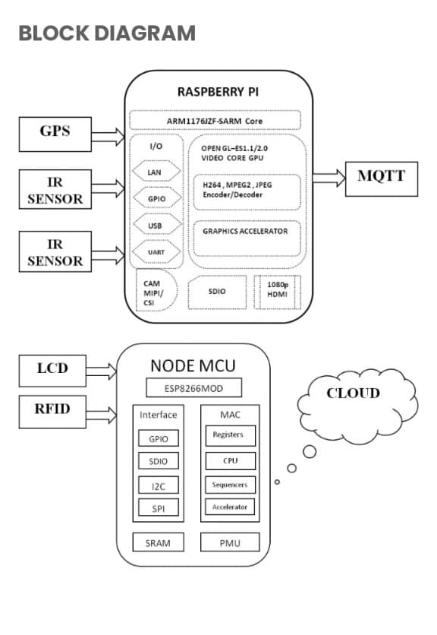
Raspberry ip integration

Slide 11
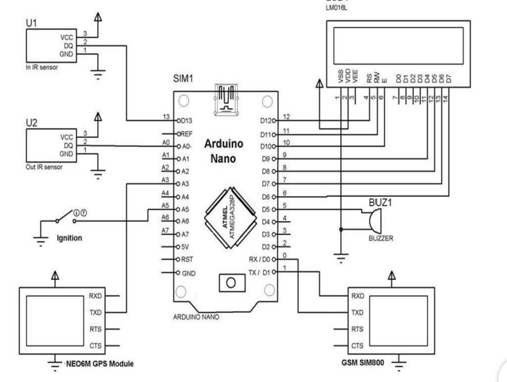
ARDUINO INTEGRATION:

Slide 12
web development
Front-End Development:
HTML5 and CSS3:For creating the structure and styling of web pages.
JavaScript: For interactive features and real-time updates on web applications.
React, Angular, or Vue.js: Popular JavaScript libraries/frameworks for building responsive, user-friendly interfaces.
Back-End Development:
Node.js, Python, Ruby, or Java: Backend server technologies to handle data processing, logic, and communication with databases.
Express.js, Django, Ruby on Rails, or Spring Boot: Frameworks that simplify back-end development.
Geospatial Technologies:
Geo JSON: A format for encoding geospatial data often used in web applications.
Open Layers, Leaflet: Libraries for displaying interactive maps on web pages.

Slide 13
Databases:
MySQL, PostgreSQL, MongoDB: Storing and managing structured and unstructured data relevant to public transport operations.
GIS (Geographic Information System) Databases:For handling geospatial data such as routes and locations.
HTTPS: Secure data transmission over the web.
Authentication and Authorization:Implementing user access controls and securing sensitive data.
Real-Time Data:
WebSockets: Enabling real-time data updates and notifications to passengers and operators.
MQTT (Message Queuing Telemetry Transport): Useful for IoT-based real-time data streaming and communication.

Slide 14
conclusion
The public transport optimization is a critical area where modern technologies, including IoT and web development, can make a significant impact. By leveraging IoT for real-time data collection and analysis, public transportation systems can enhance efficiency, safety, and the overall passenger experience. Meanwhile, web development technologies play a key role in building user-friendly applications and systems that provide real-time information, route planning, and seamless passenger services. The successful integration of these technologies can lead to more sustainable, accessible, and efficient public transportation networks that benefit both passengers and operators. As technology continues to advance, public transport optimization will likely become even more sophisticated and effective, contributing to the improvement of urban mobility and reducing environmental impact.

Slide 15
Thank you

